Slide 1
Terra-Table
Topographical Terrain Table for D&D and Other Tabletop Games
Quinton Woodward, Luke Sferrella, & Connor Hyde | Senior capstone final presentation

Slide 2
Project Background
Why Terra-Table?

Slide 3
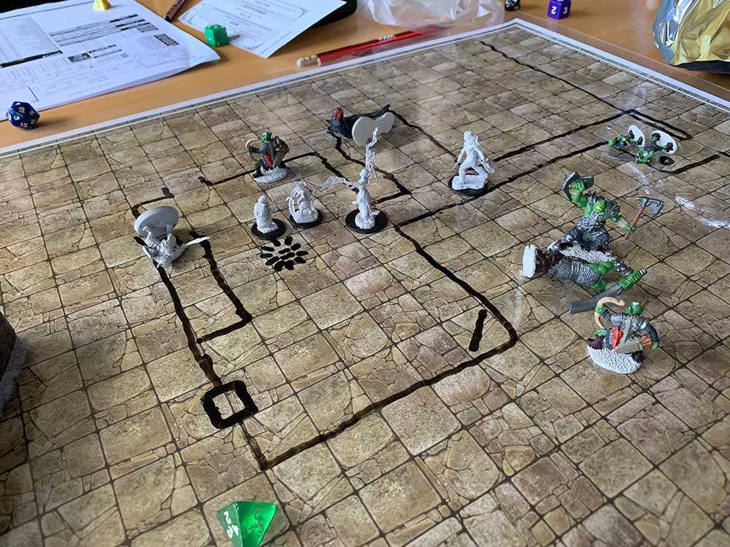

Dungeons and dragons
Senior capstone final presentation
Tabletop role playing game
Mini-figures/sculptures create depth
Battle map provides scale

Slide 4
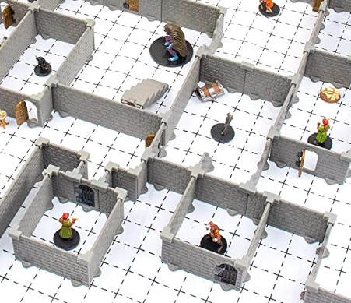
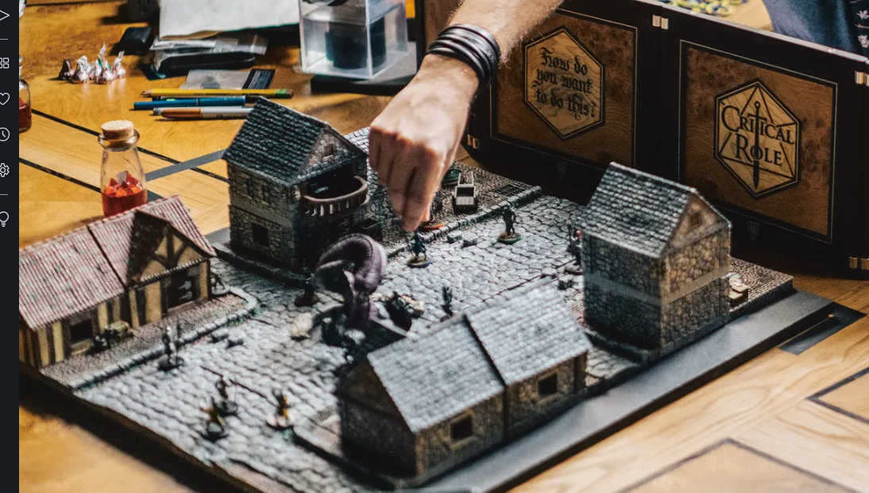
Low Tech solutions
Senior capstone final presentation
Modular kits with blocks/walls
3D printing terrain
Elaborate dioramas

Slide 5
Project Requirements
Objectives, Constraints, Codes/standards

Slide 6
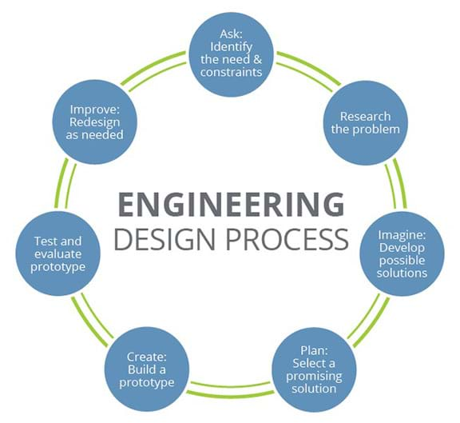
Project Objectives
Senior capstone final presentation
Key Success Factors
Project outline and road-mapping
Task on-time delivery
Budget/Expense tracking
Advisor check-ins
Design device to display topography in 3D
Build and integrate operation software
Assemble and test prototype

Slide 7
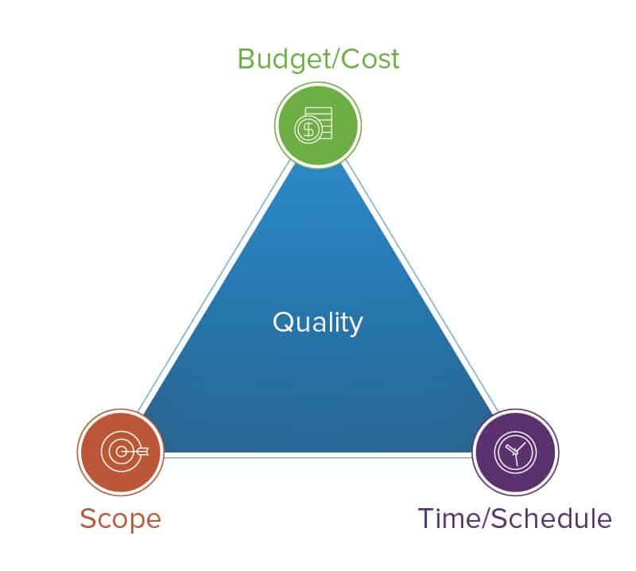
Constraints
Senior capstone final presentation
Economic
Prototyping Cost
Independent Funding
Strict Budgeting
Manufacturing
Minimal 3rd Party Usage
Rapid Prototyping Cost
Team Member Build Hours
Specifications
Consumer Product Safety Commission
ASTM F963 Toy Safety
Sustainability
Component Quantity
Material Selection
Purchased vs. Manufactured Parts
Health/Safety
Consumer Product Restrictions
User Interface Safety
Toxic Chemical Exposure
Environmental
Manufacturing Waste Management
Ethical
“Do No Harm” Engineering Principles
Copywrite/Patent Violations

Slide 8

Standards and Codes
Senior capstone final presentation
Consumer standards for safety, construction, and testing:
Consumer Product Safety Commission
Title 16 CFR Chapter II Subchapter B: Consumer Product Safety Act Regulations
Part 1250 – Requirements for tabletop toy acoustic emissions
ASTM F963-17
Pinch Points
Mechanical Entrapment
Testing procedures
Testing equipment
Material Property Codes
ASTM B221 – Material parameters for load bearing parts

Slide 9
Project Design
how Terra-Table?

Slide 10
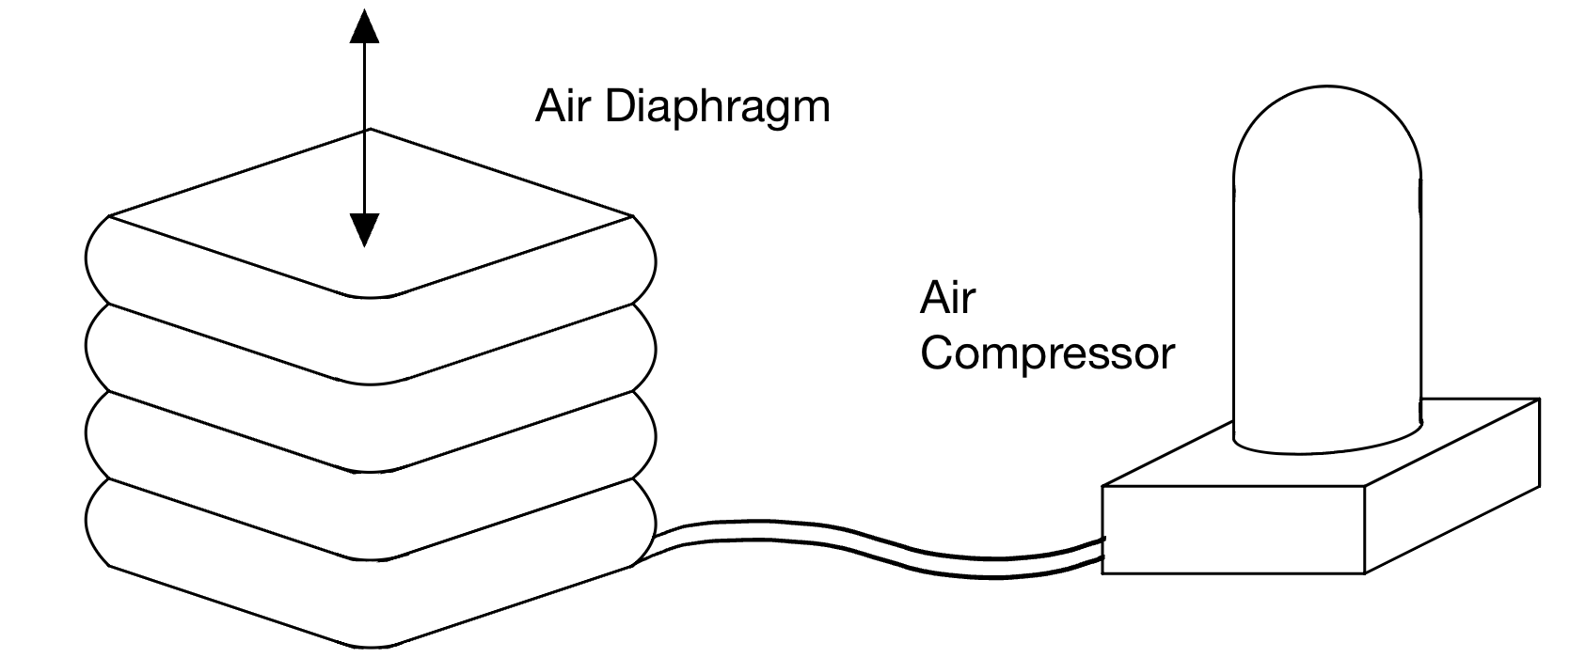
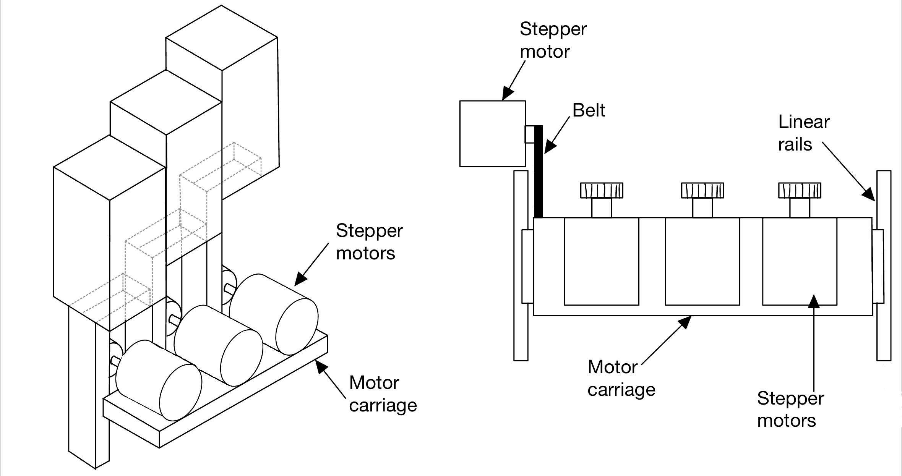
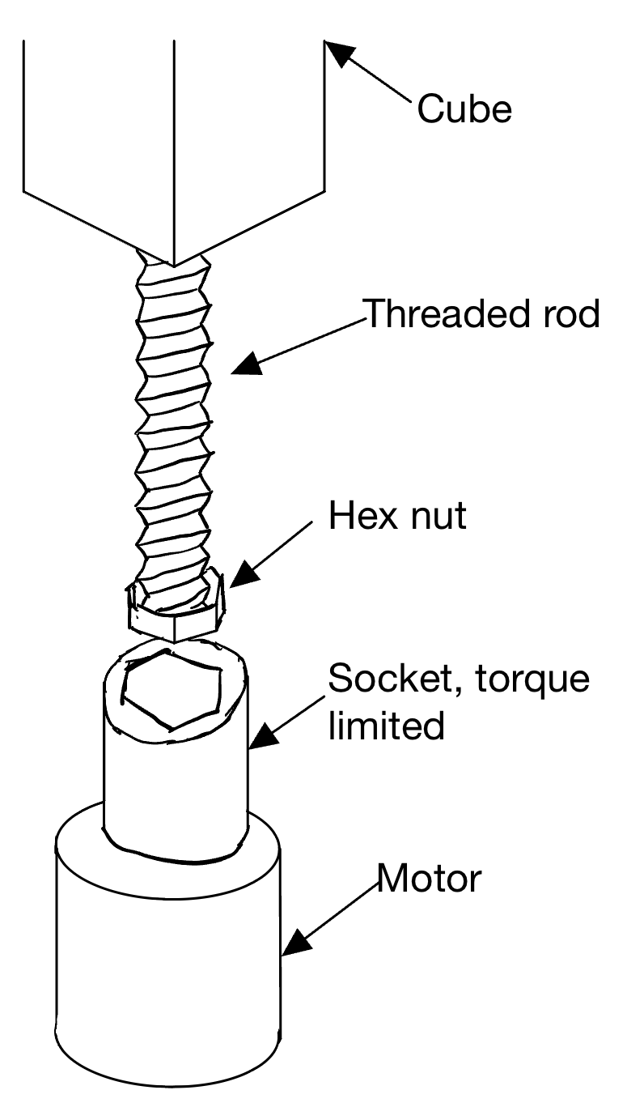
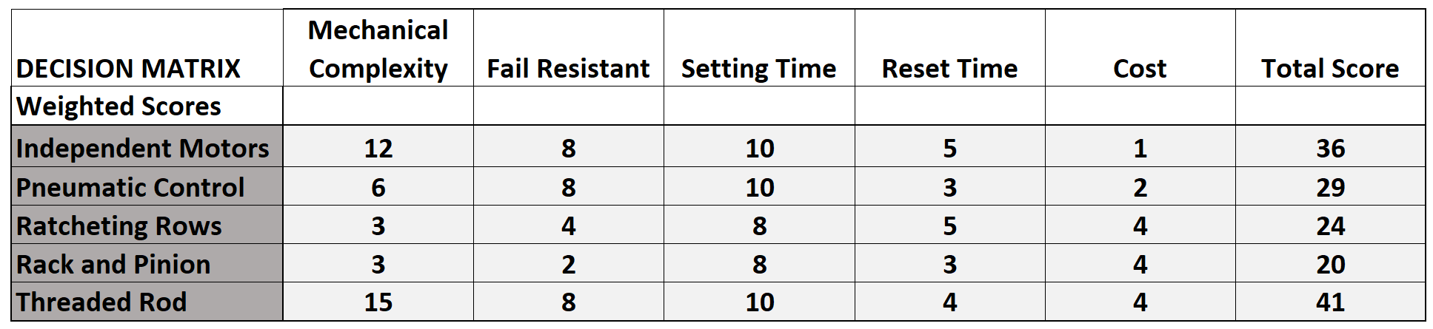
Design Process
Senior capstone final presentation

Slide 11
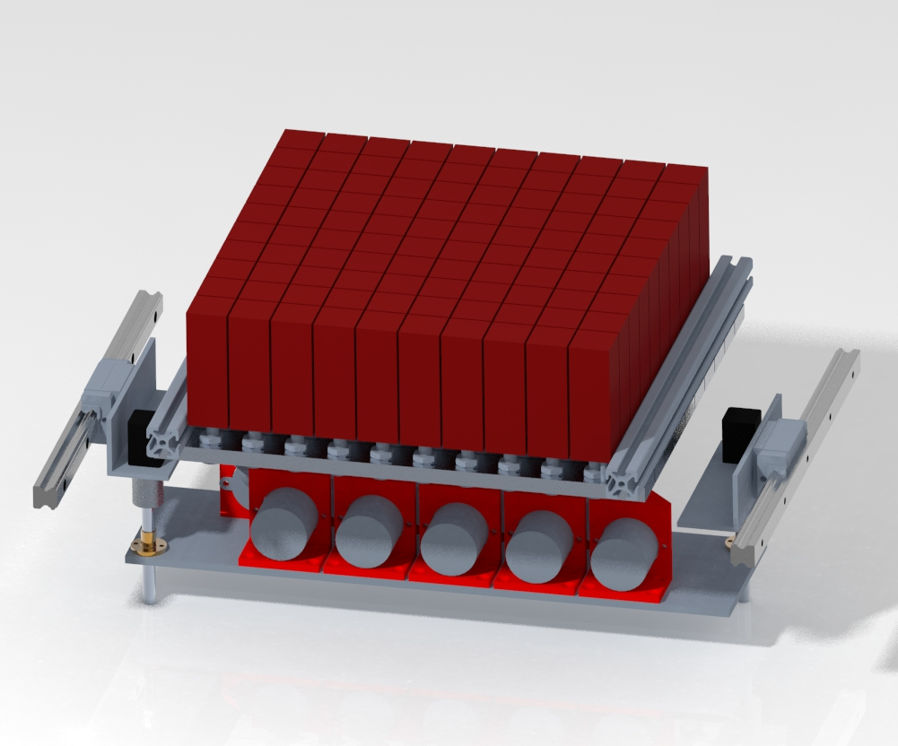
Finalized design
Senior capstone final presentation
Blocks ride on threaded rod
10 motors adjust block height row by row
Additional motors control gantry position

Slide 12
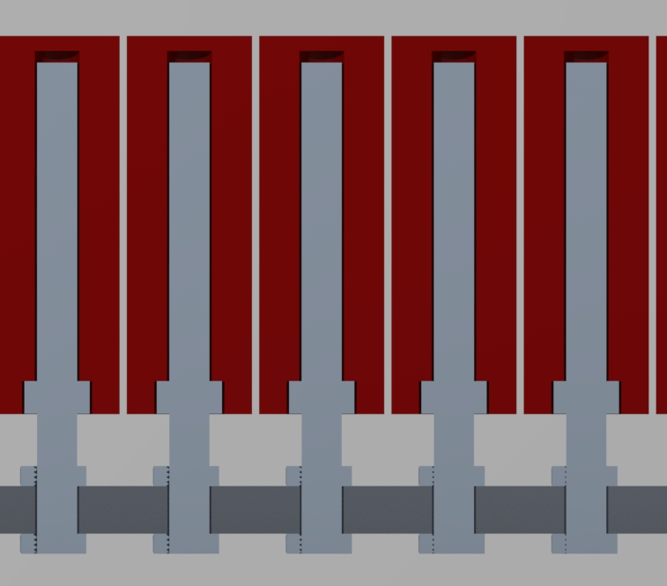
Sub-system: Block Gantry
Senior capstone final presentation
8mm Threaded Rod
3D Printed Block
Captive Hex Nut
Aluminum Plate

Slide 13
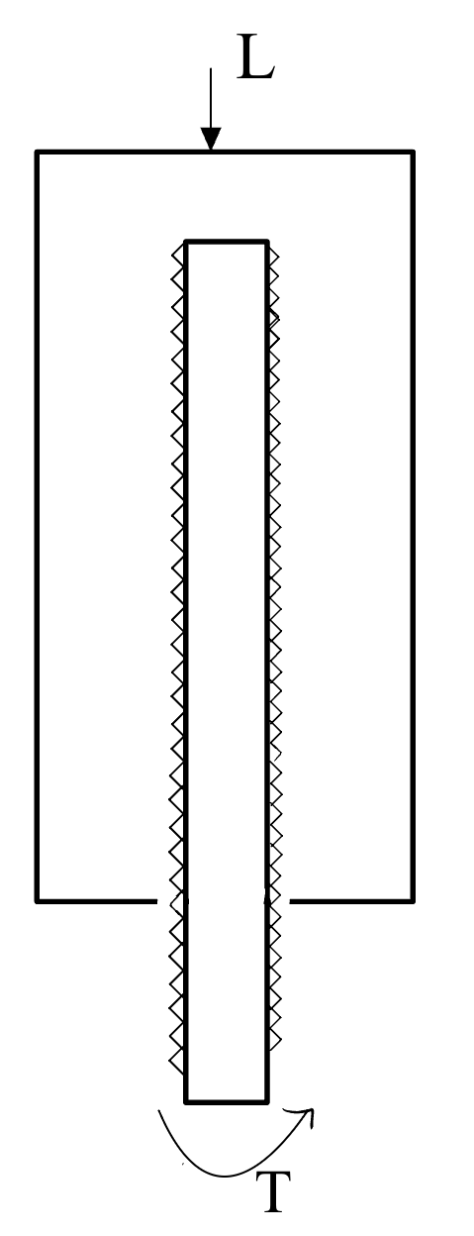
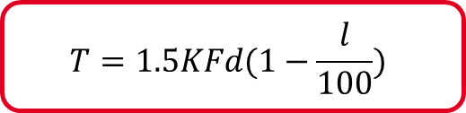
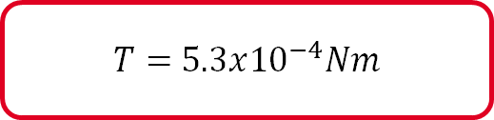
Required Motor Torque
Relationship between torque and axial load
Maximum torque impacts motor selection
Key Factors
Bolt geometry
Lubrication
Bolt material/plating
$$T=1.5KFd(1−\frac{l}{100})$$
$T=$ $5.3x{10}^{−4}Nm$
T = Torque (Nm)
K = Bolt Constant
d = Nominal Bolt Dia. (m)
F = Axial Bolt Force (N)
l = Lubrication Factor

Slide 14
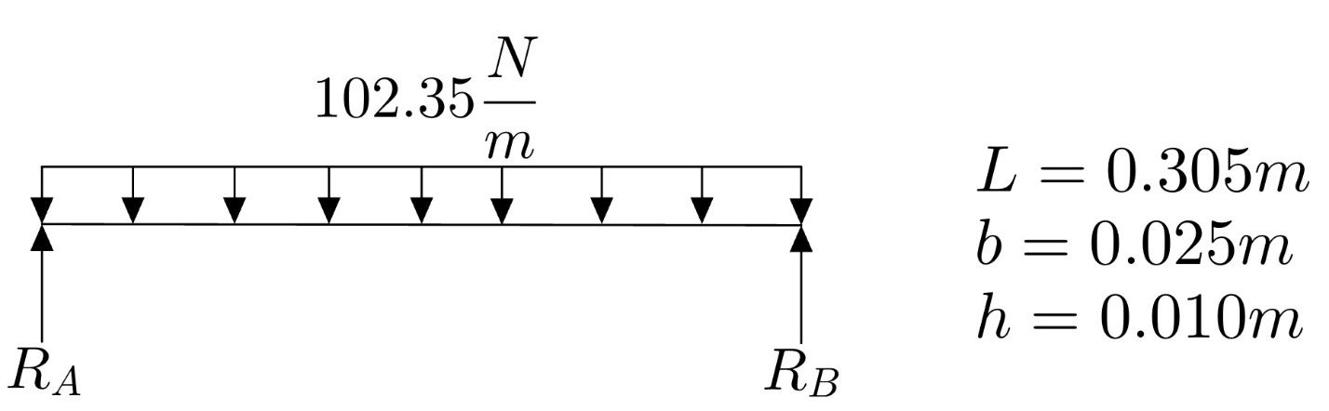



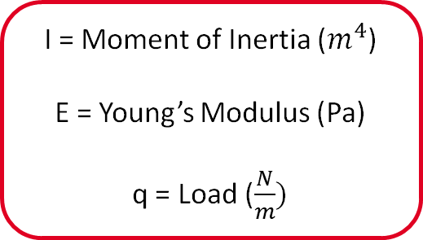
Block Support Gantry
Loads cause deflection
Excess deflection would prevent operation
Key Factors
Gantry geometry
Gantry material
Load quantity/distribution
$$I=\frac{1}{12}bh^{3}$$
$$δ_{max}=\frac{qL^{4}}{384EI}$$
I = Moment of Inertia ($m^{4}$)
E = Young’s Modulus (Pa)
q = Load ($\frac{N}{m})$
$δ_{max} =$ $0.01mm$

Slide 15
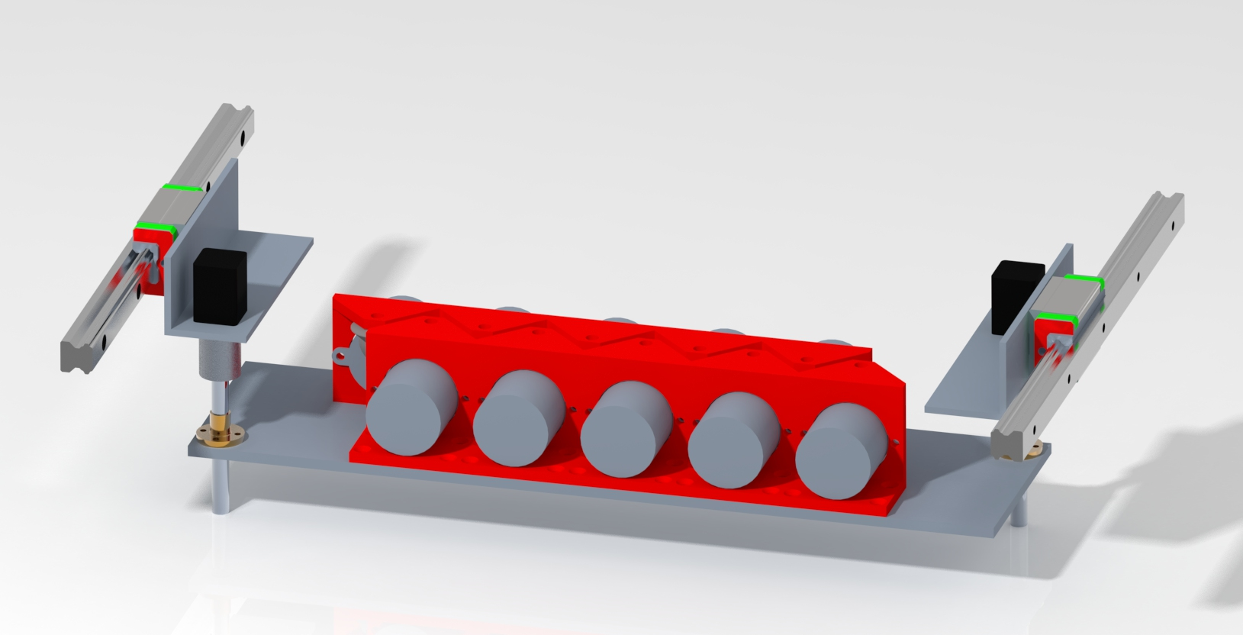
Sub-System: Motor Gantry
Senior capstone final presentation
Aluminum gantry supports adjustment motors
Mounting brackets houses gearing and supports sockets
Lead screws adjust gantry height
Linear rails allow for movement between rows

Slide 16
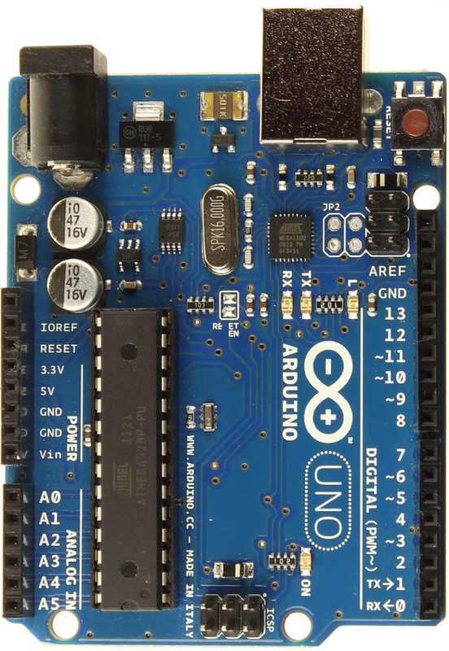
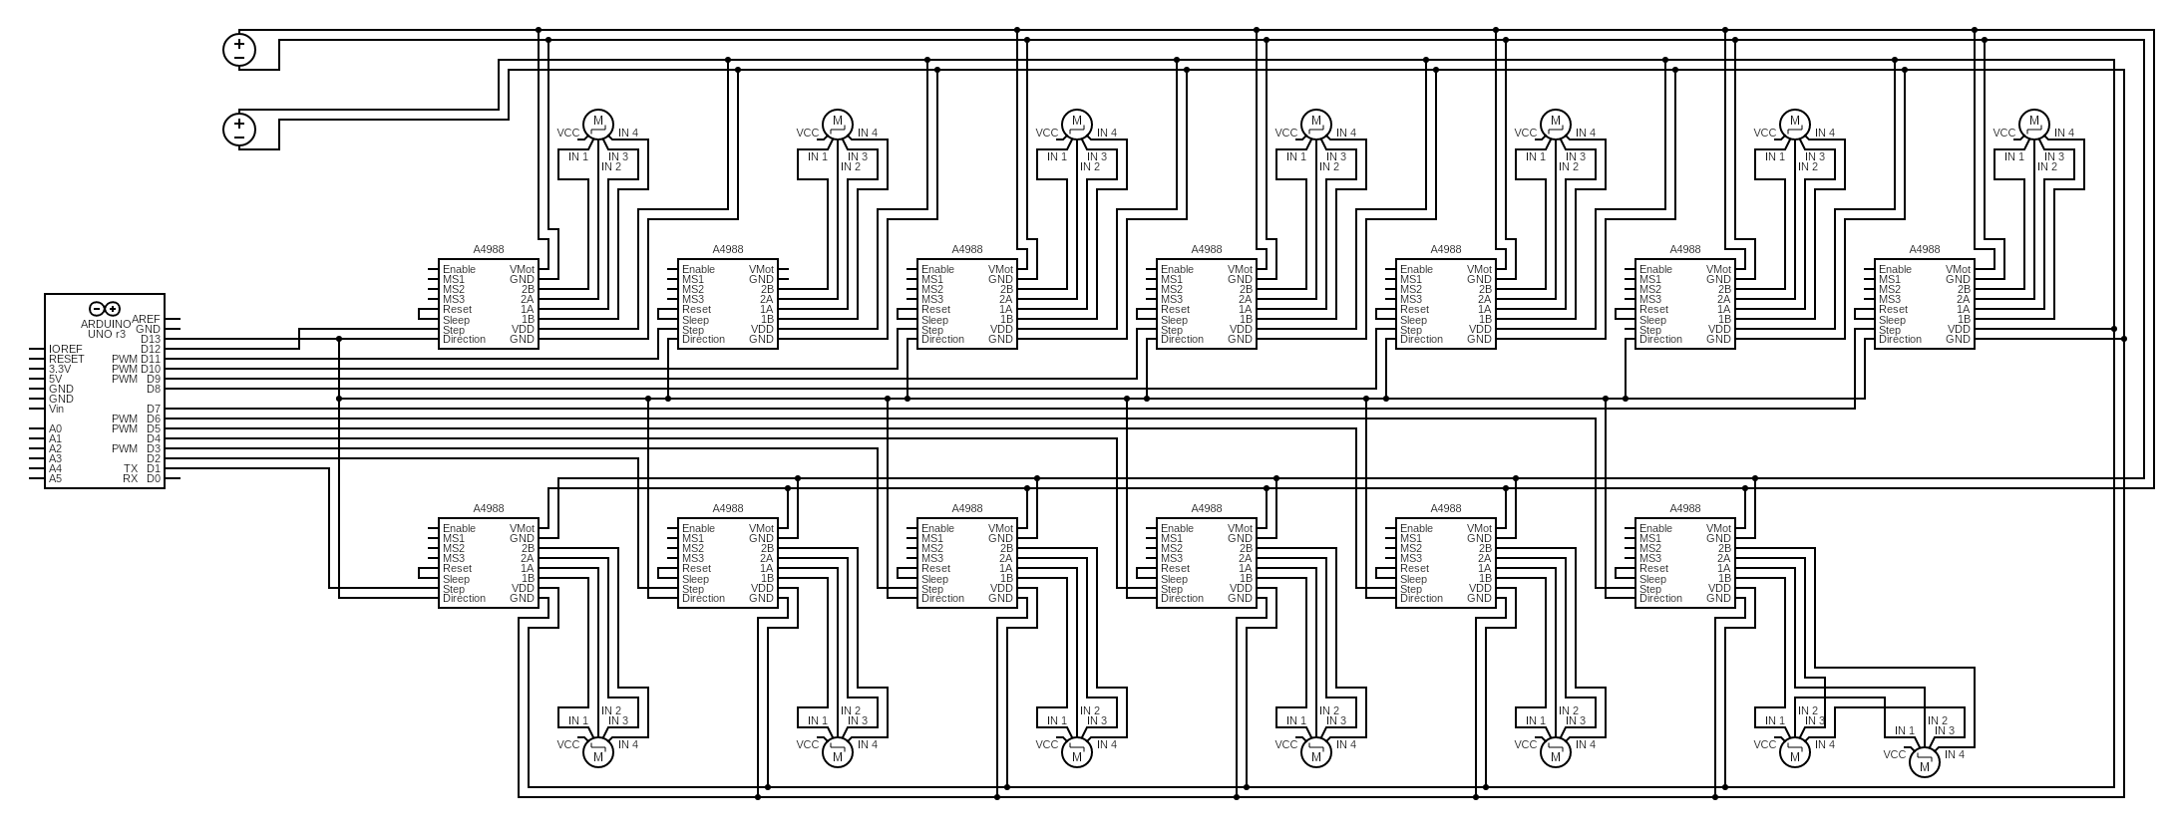
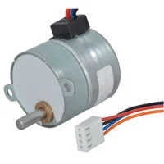
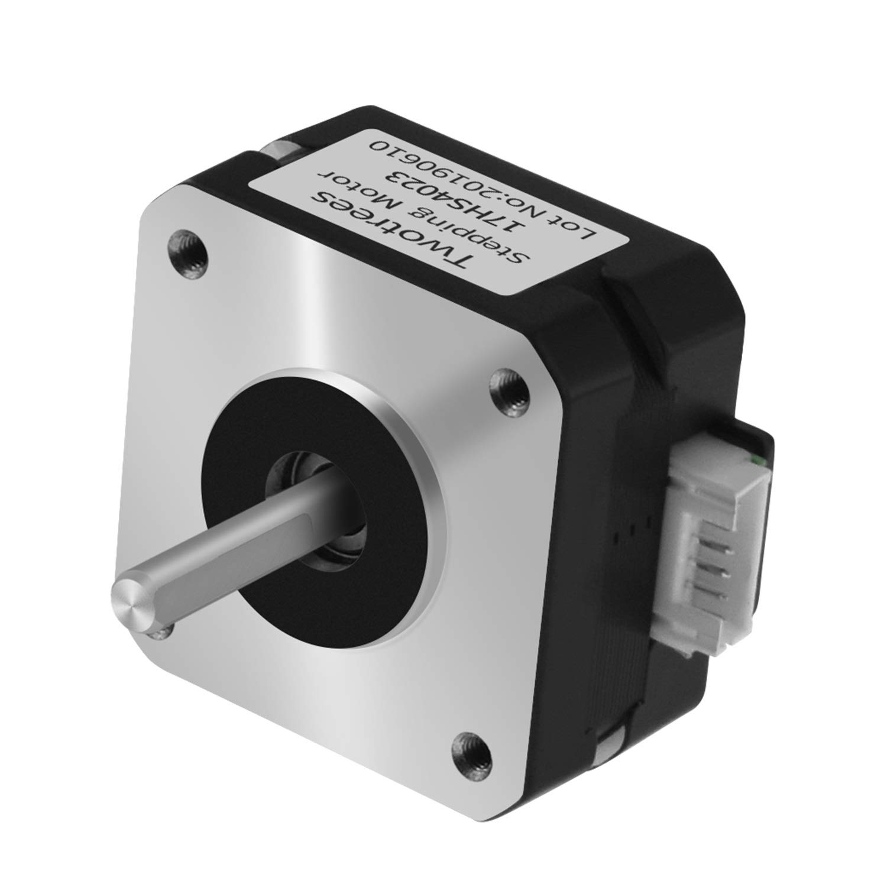
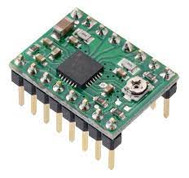
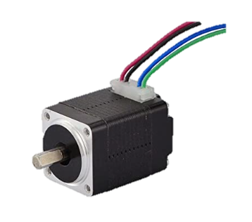
Circuit diagram
Senior capstone final presentation
24 VDC
5 VDC

Slide 17
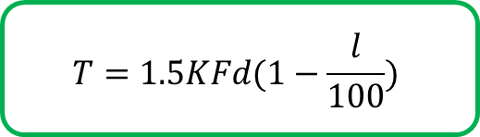
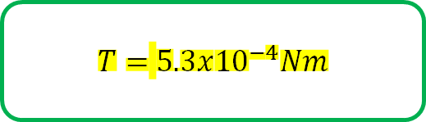
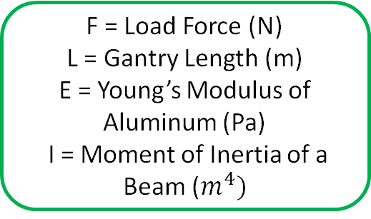

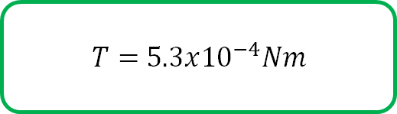
Sample calculations
ue of
5.3x10−4N
m.
Senior capstone final presentation
ue of
5.3x10−4N
m.
Motor Torque Due to Bolt Load
Approximate Gantry Deflection
Required Electrical Power
$$T=1.5KFd(1−\frac{l}{100})$$
$$D=\frac{FL^{4}}{384 EI}$$
P = IV
T = Torque (Nm)
K = Bolt Constant
d = Nominal Bolt Dia. (m)
F = Axial Bolt Force (N)
l = Lubrication Factor
F = Load Force (N)
L = Gantry Length (m)
E = Young’s Modulus of Aluminum (Pa)
I = Moment of Inertia of a Beam ($m^{4})$
P = Power (W)
I = Current (A)
V = Voltage (V)
$T=$ $5.3x{10}^{−4}Nm$
$T=$ $5.3x{10}^{−4}Nm$
P = 78W

Slide 18
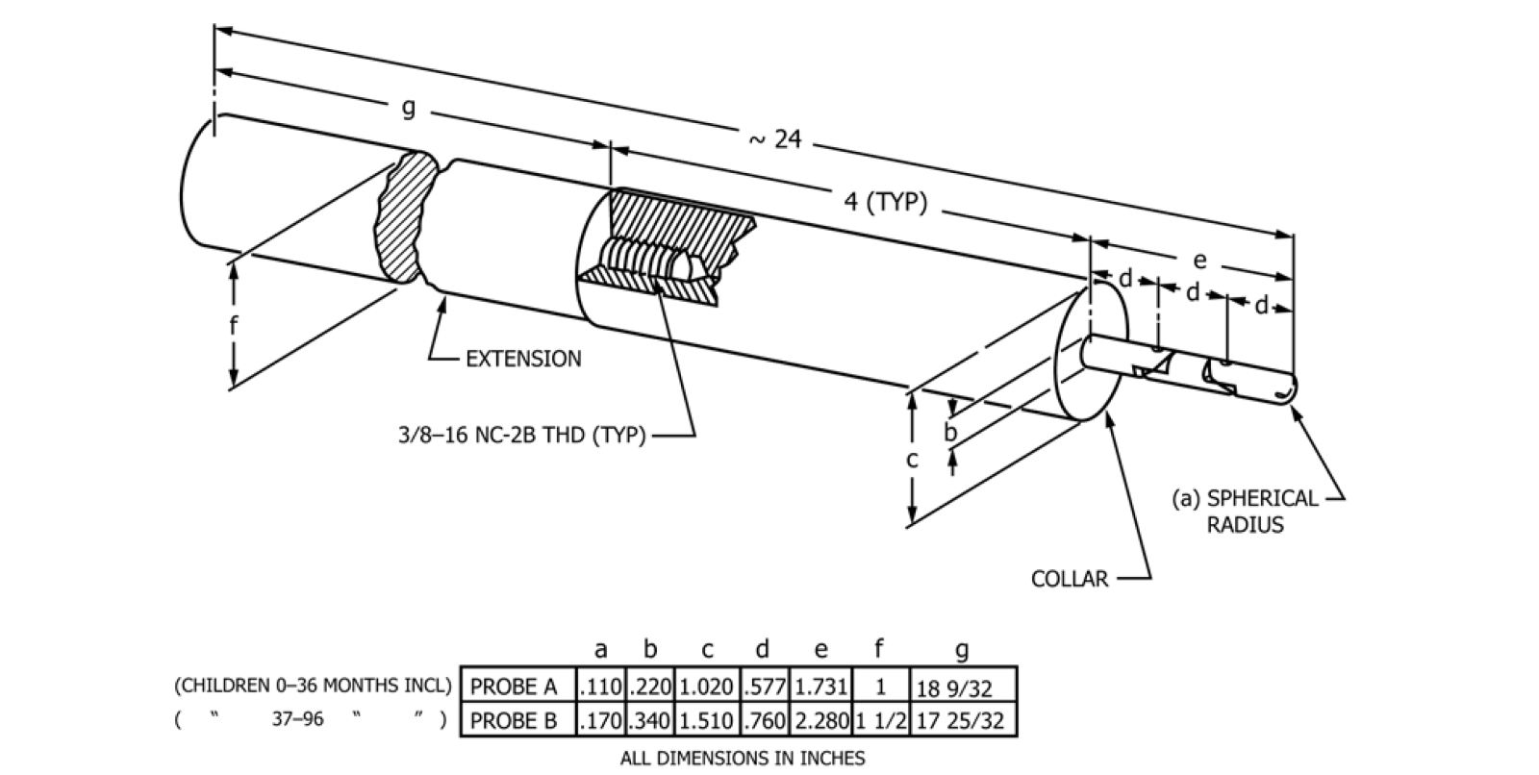
Standard and Code Limitations
Senior capstone final presentation
Safety Hazard | Acceptance Criteria | Testing Method | Testing Results
Acoustic Emissions | Toy Produces <85dB | Phone Application | Incomplete
Mechanical Pinch Points | ASTM Probe Cannot Fit In Any Gaps Up to the Collar | 3D Printed Model Probe | 0-36 Month – FAIL 37-96 Month - PASS

Slide 19
Computer Science Additions
Code Flow, information handling, GUI

Slide 20
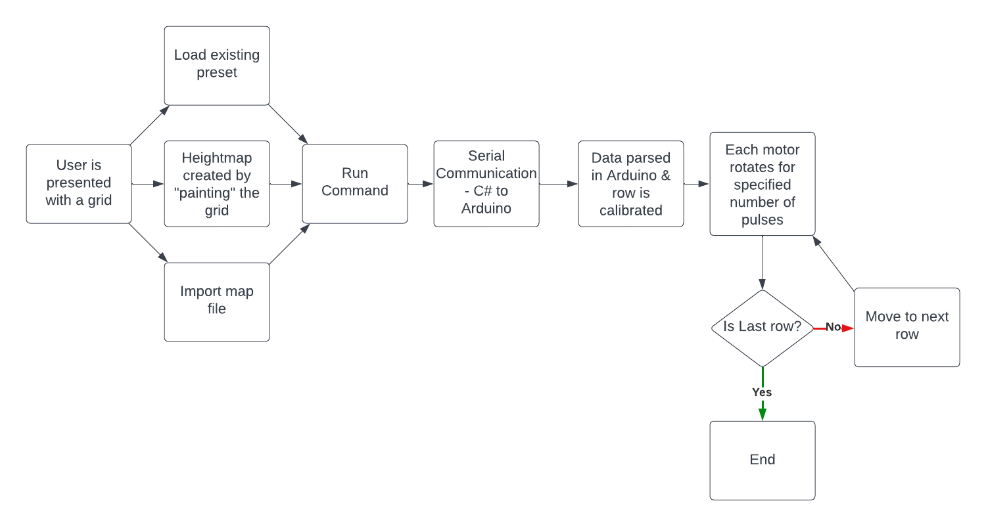
Code Flowchart
Senior capstone final presentation

Slide 21
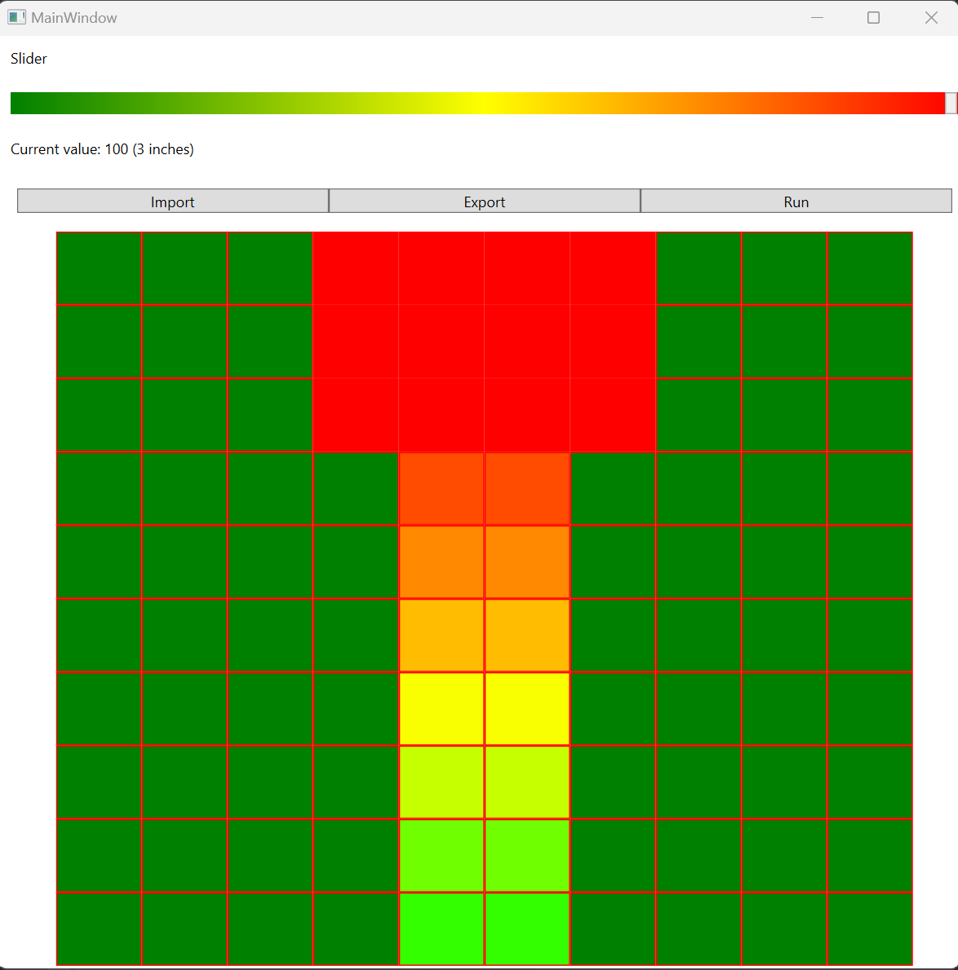
GUI
Senior capstone final presentation

Slide 22
Project Recap
how Terra-Table?

Slide 23
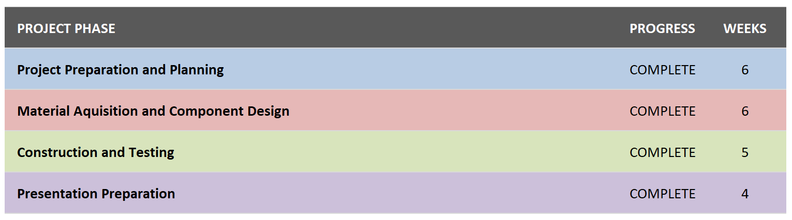
Project Schedule
Senior capstone final presentation

Slide 24
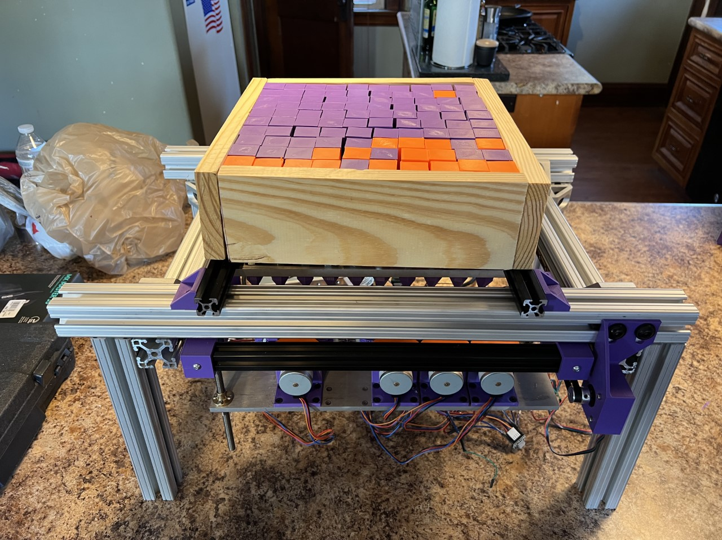
Prototype
Senior capstone final presentation

Slide 25
Project Overview
Senior capstone final presentation
Possibilities for Future Work
Areas for Improvement
Set intermediate goals
Follow weekly meeting schedules
Factors for Success
Regular Advisor Meetings
Divide and Conquer Project Build
Preemptive Budgeting Prevents Over-Spending
Improve quality of components
Replace 80/20 frame
Upgrade to encoded motors
Improve wire management
Replace 3D printed materials
Integrate design into a physical table

Slide 26
Thank you

